Slide 1


Melodify
HelloHacks 2024
Adrian, Renata, Bernard, Geoff

Slide 2
Roadmap
01
Target User
Who is this product intended for?
02
Problem
What is the main issue these users face?
03
Solutions
Available fixes to consider
04
Features
Our projects features and how they work

Slide 3
Who Is Our Target Audience?
Youth
RCM Exams
Busy but Eager
Prudent
Pre-teens and youth who are currently learning music theory
Focused towards those taking an RCM exam
Keen to learn music theory but occupied with extracurriculars
Seeking quality resources while being mindful of their spending

Slide 4
What Problems Do They Face?
Uninspiring Textbooks
Exam Anxiety
Lack of Resources
Textbooks are outdated and unappealing, and are not interactive nor user friendly
Without enough practice, they feel unprepared and worry about their results
Not enough resources online to learn and further practice music theory

Slide 5


Current Music Theory Resources
Musictheory.net
Music Theory Workbooks
Bland, uninspiring interface and structure
Headache-inducing, plain workbook format

Slide 6
What Are Possible Solutions?
Modernize the UI and improve the intuitiveness of searching for information
Add various interactive elements to enhance engagement and learning
Promote information retention and understanding by providing questions for users

Slide 7
Methods and Solutions
01
02
03
Interactive Content and Multimedia
Engaging tasks and auditory immersion for students
Questions and Feedback
Provide frequent assessments to encourage learning
Contemporary UI
Visually appealing and clear presentation improving fo

Slide 8
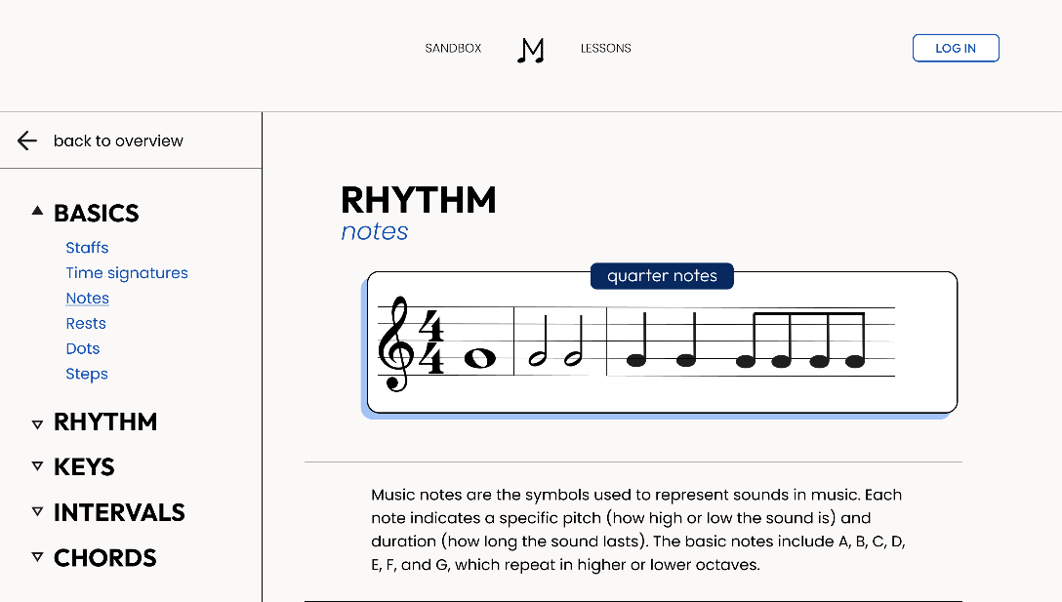

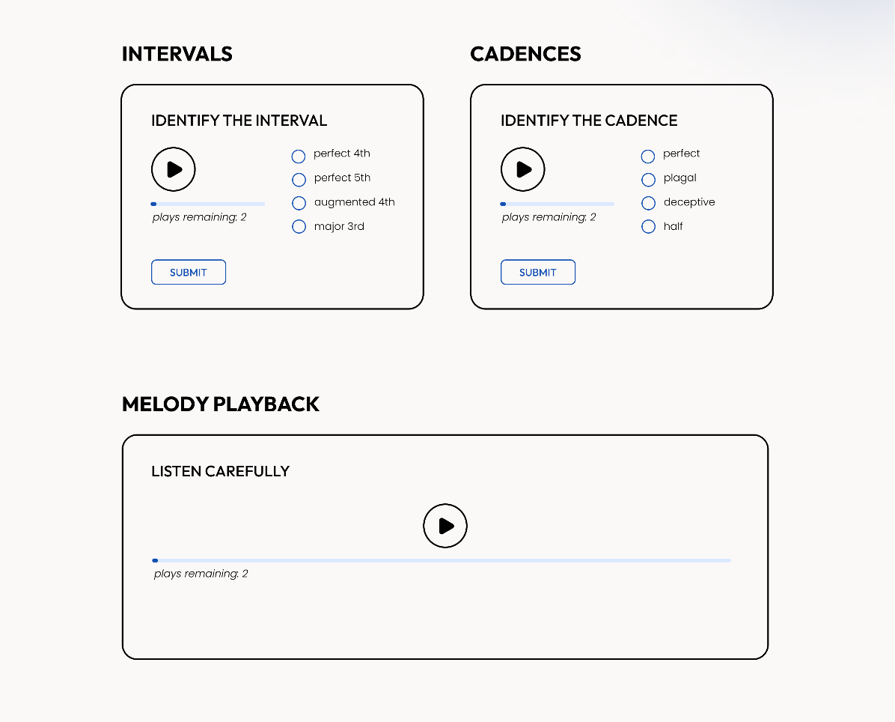
01
Interactive Content and Multimedia
Easy to reach sidebar to jump between lessons
Jump to explanations by clicking on topics
Summaries by hovering over topics
Play sample audios to practice ear training

Slide 9
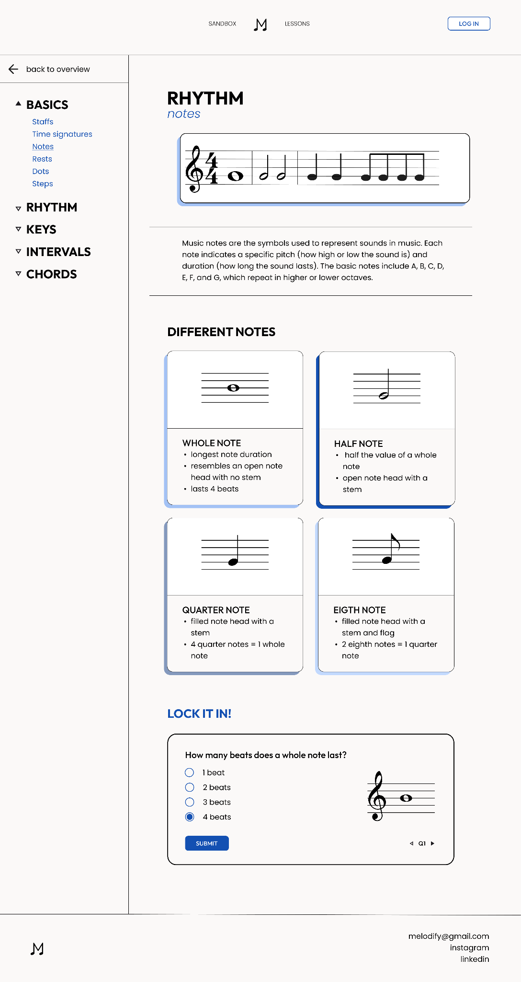

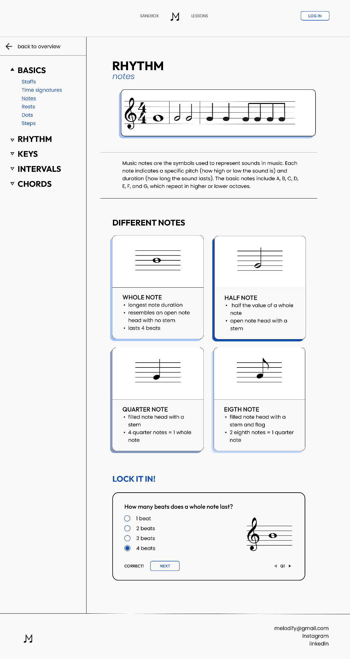
02
Questions and Feedback
Gauge understanding by practicing problems
Receive instant feedback on each topic

Slide 10
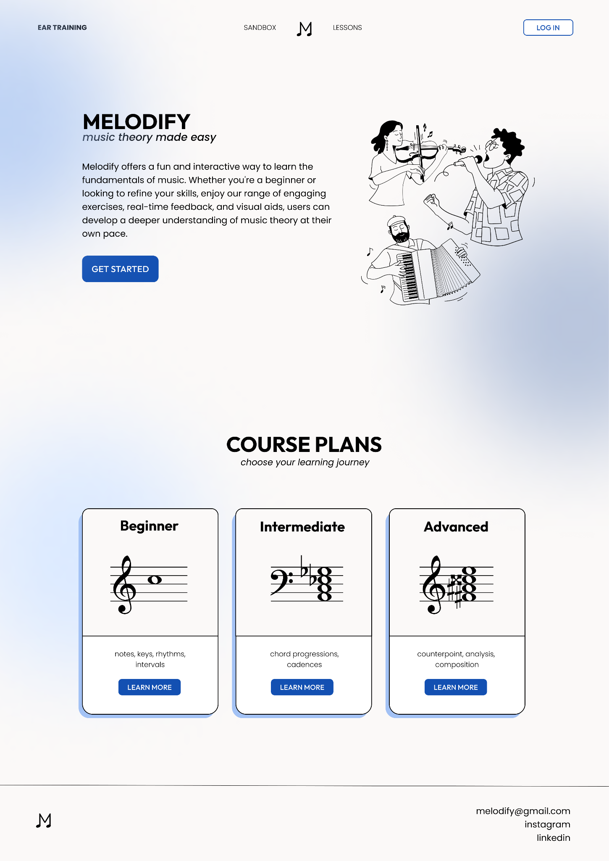
03
Contemporary UI
Visually appealing designs with cool tones help maintain concentration and reduce frustrations
Clear presentation of information to simplify website navigation

Slide 11
Further Improvements & Features
Generative Sandbox Mode | Log In/Progress Tracking | AI Generated Listenings | Daily Check-Ins
Supplementary materials provided to practice for exams | Tracks progress in lessons and notes where you stopped | Create RCM-style ear training exercises | Encourages consistency and helps users stay on track with goals
JavaScript | Relational Database | AI model training | User Database
Song title 1 Song title 2 Song title 3 | PostgreSQL with user, question bank OAuth for quick user setup | Gather RCM audio examples to train model like WaveNet Set up API to send to front-end | Mobile app to allow for daily notifications Swift, Kotlin

Slide 12
Thank You For Listening!
Do you have any questions?

